Slide 1
Fundamentals of CRE
Chemical Reaction Engineering
By
Dr Salah N. Farhan
Senior lecturer. Chem. Eng. Dept.
College of Engineering
University of Diyala
Salah N. Farhan College of Engineering Diyala University

Slide 2
Fundamentals of CRE
Chapter 4: Stoichiometry
Learning Resources
Summary Notes
Stoichiometry
Batch System Stoichiometric Table
Flow System Stoichiometric Table
Salah N. Farhan College of Engineering Diyala University

Slide 3
Fundamentals of CRE
Salah N. Farhan College of Engineering Diyala University

Slide 4
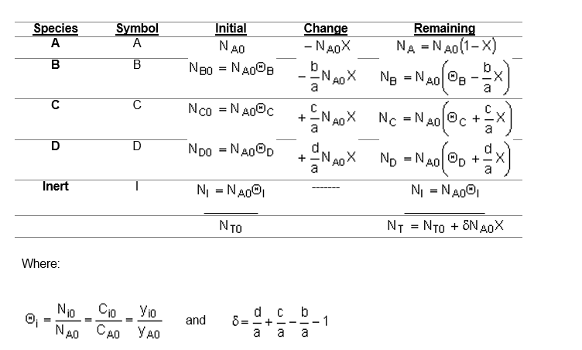
Fundamentals of CRE
Topics
Batch System Stoichiometric Table
Flow System Stoichiometric Table
Concentration -- Batch System
Salah N. Farhan College of Engineering Diyala University

Slide 5
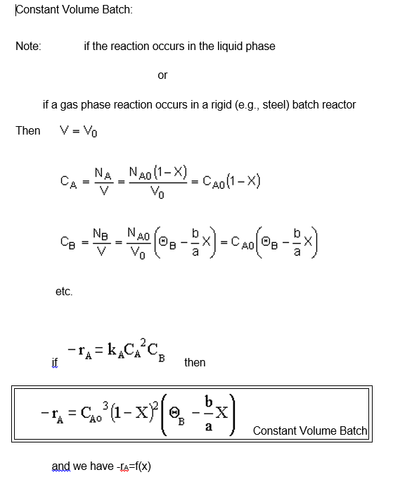
Fundamentals of CRE
Salah N. Farhan College of Engineering Diyala University

Slide 6
Fundamentals of CRE
Salah N. Farhan College of Engineering Diyala University

Slide 7
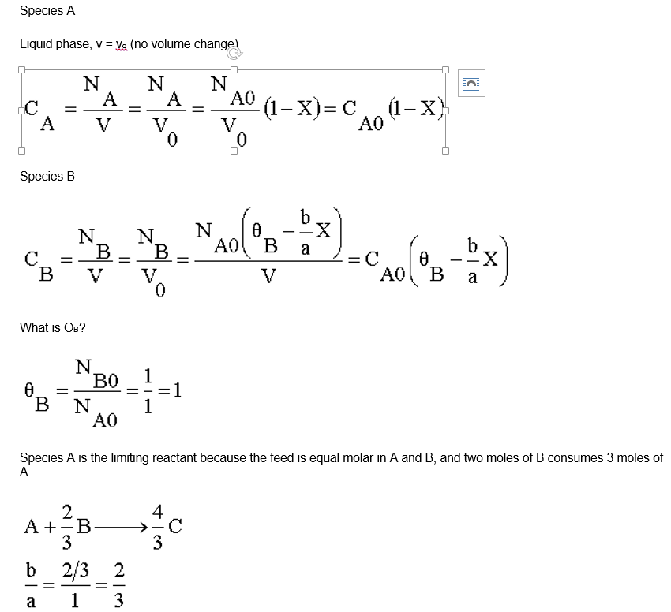
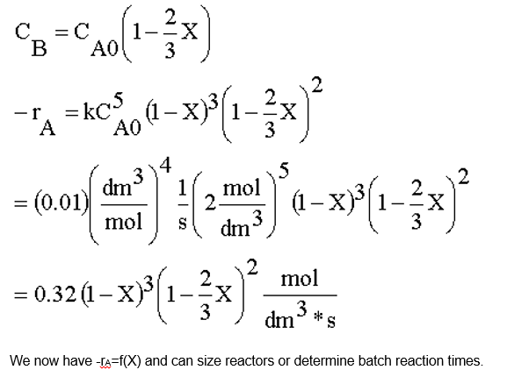
Fundamentals of CRE
Salah N. Farhan College of Engineering Diyala University

Slide 8
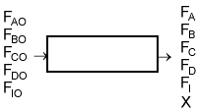
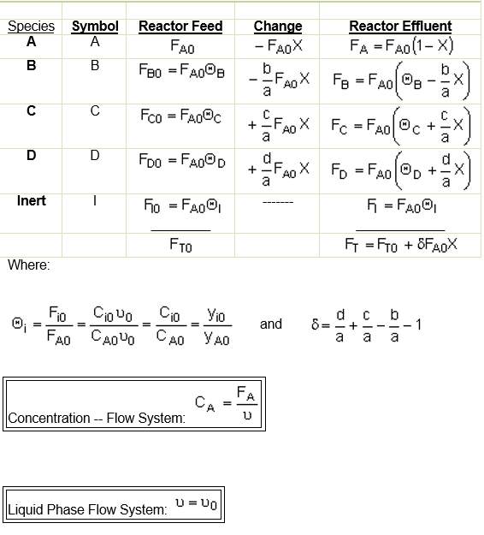
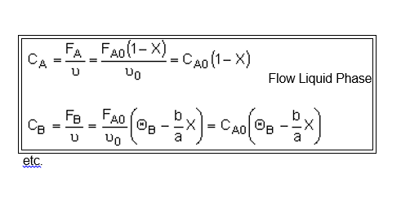
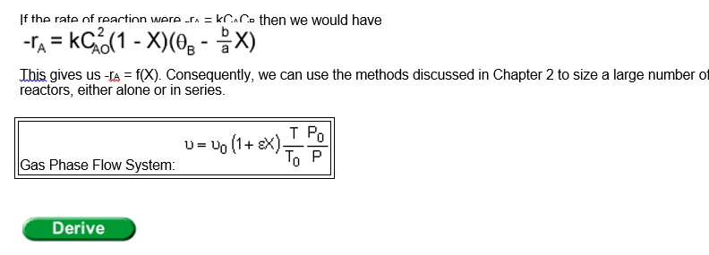
Fundamentals of CRE
Flow System Stoichiometric Table
Salah N. Farhan College of Engineering Diyala University

Slide 9
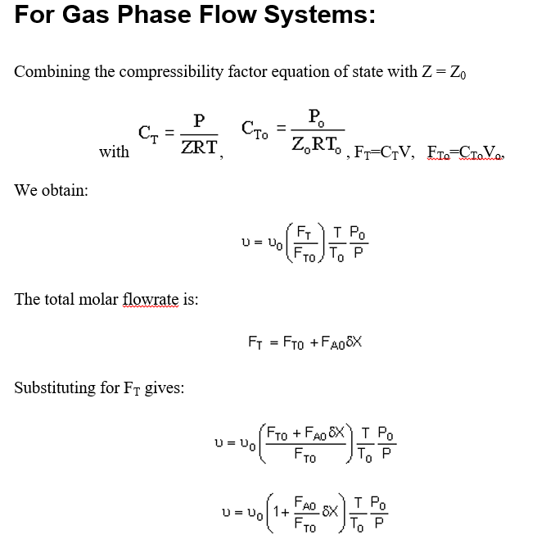
Fundamentals of CRE
Salah N. Farhan College of Engineering Diyala University

Slide 10
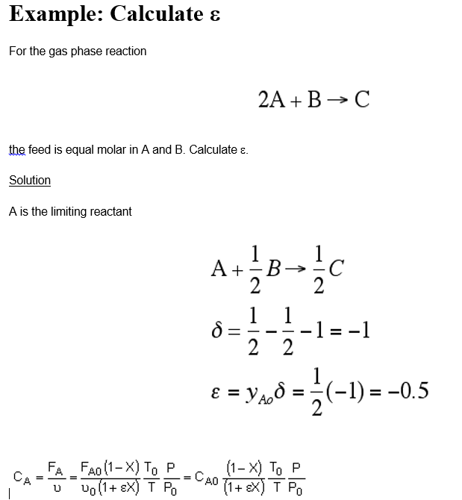
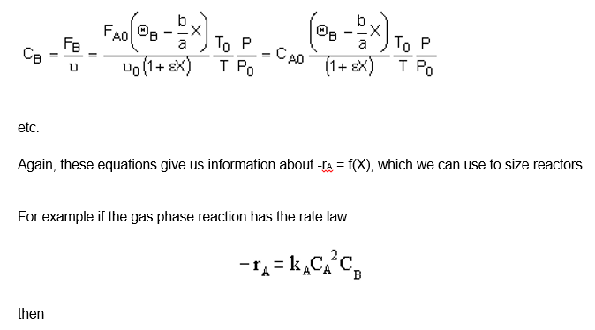
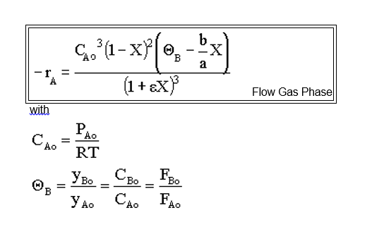
Fundamentals of CRE
Salah N. Farhan College of Engineering Diyala University

Slide 11
Fundamentals of CRE
Salah N. Farhan College of Engineering Diyala University

Slide 12
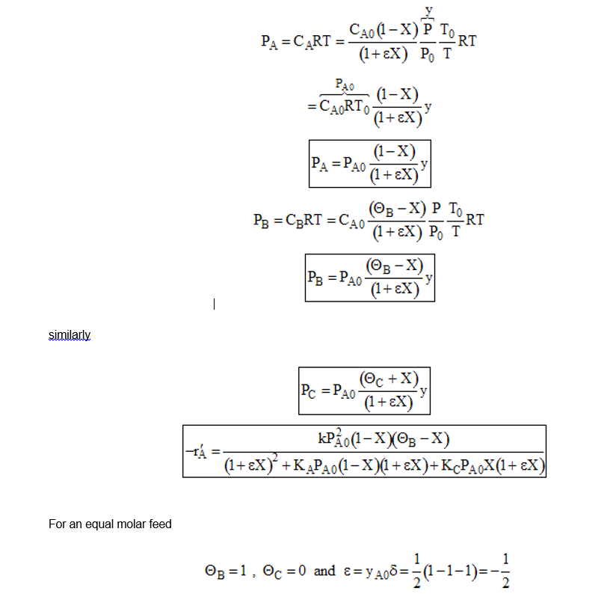
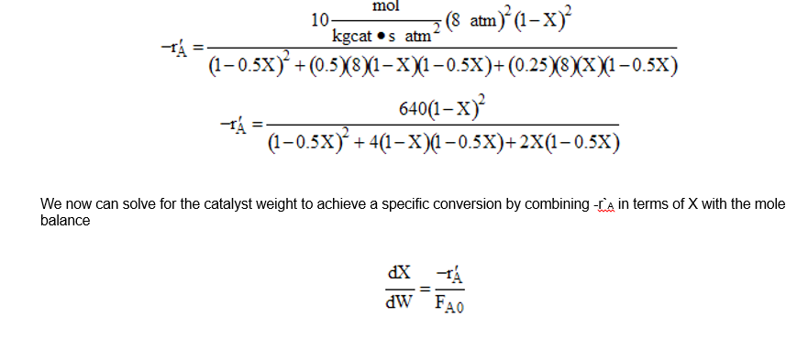
Fundamentals of CRE
Salah N. Farhan College of Engineering Diyala University

Slide 13
Fundamentals of CRE
Salah N. Farhan College of Engineering Diyala University

Slide 14
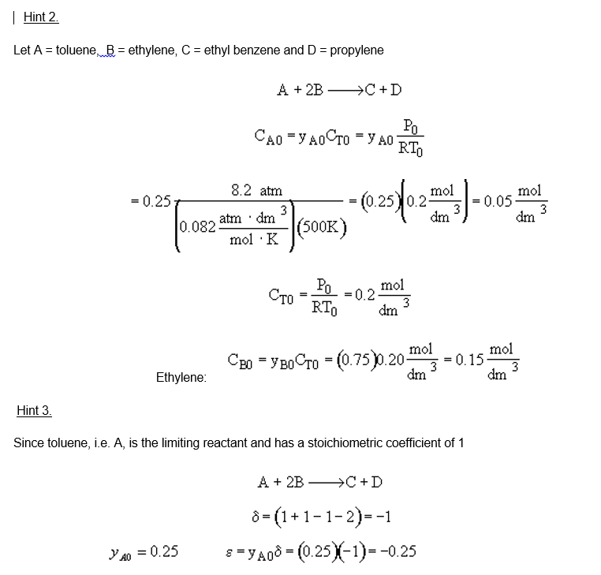
Fundamentals of CRE
Salah N. Farhan College of Engineering Diyala University

Slide 15
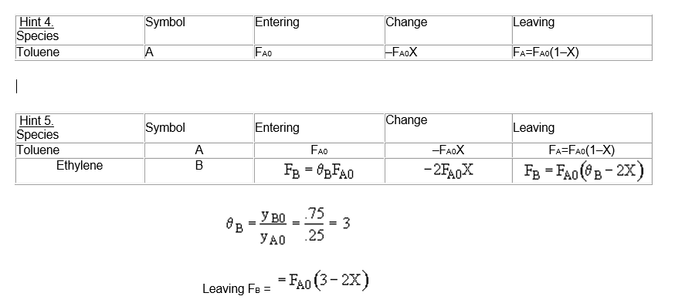
Fundamentals of CRE
Salah N. Farhan College of Engineering Diyala University

Slide 16
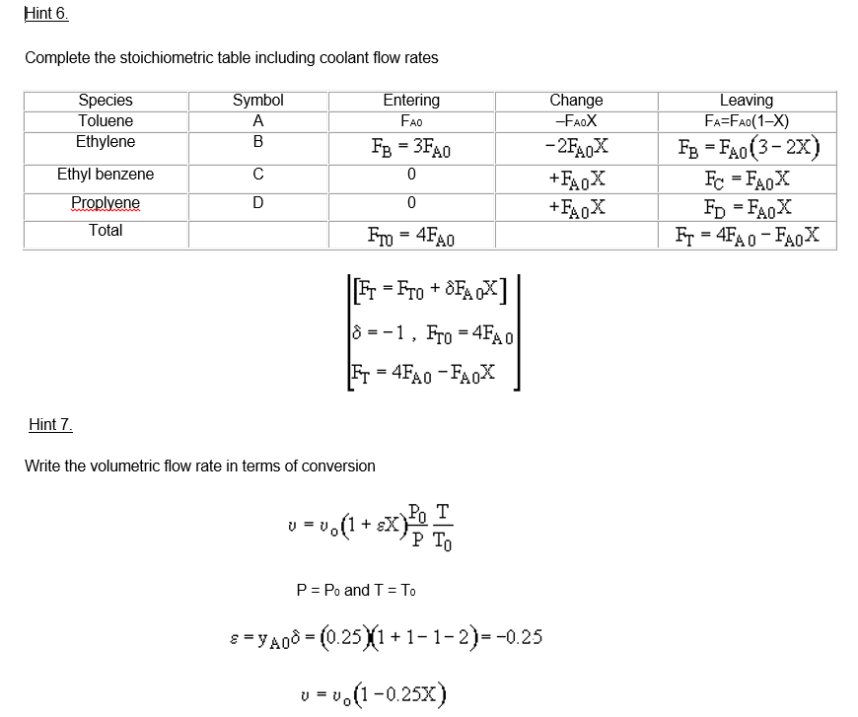
Fundamentals of CRE
Salah N. Farhan College of Engineering Diyala University

Slide 17
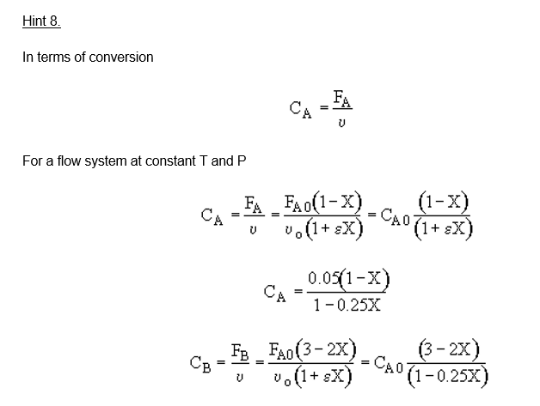
Fundamentals of CRE
Salah N. Farhan College of Engineering Diyala University

Slide 18
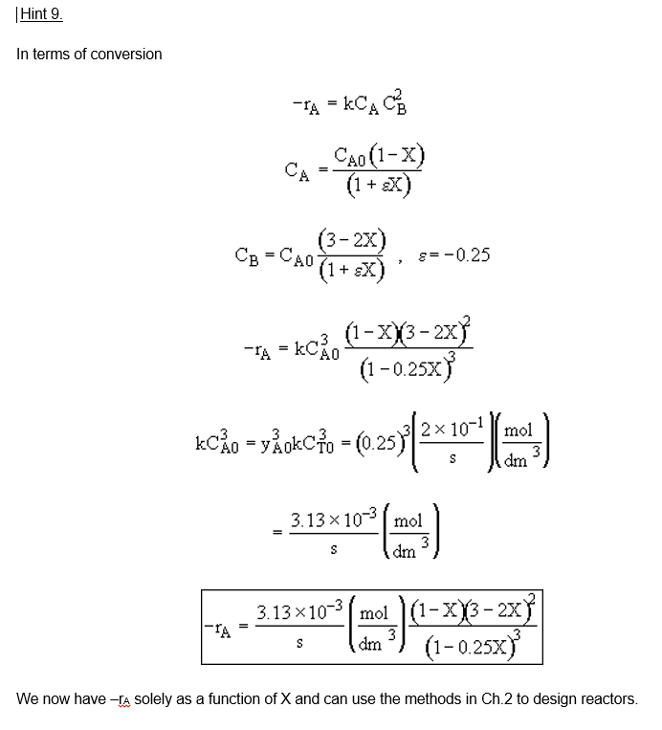
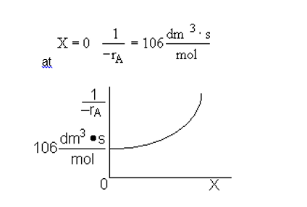
Fundamentals of CRE
Salah N. Farhan College of Engineering Diyala University

Slide 19
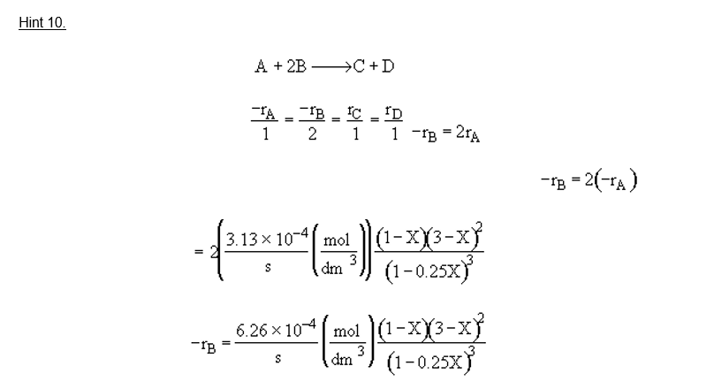
Fundamentals of CRE
Salah N. Farhan College of Engineering Diyala University

Slide 20
Fundamentals of CRE
Salah N. Farhan College of Engineering Diyala University

Slide 21
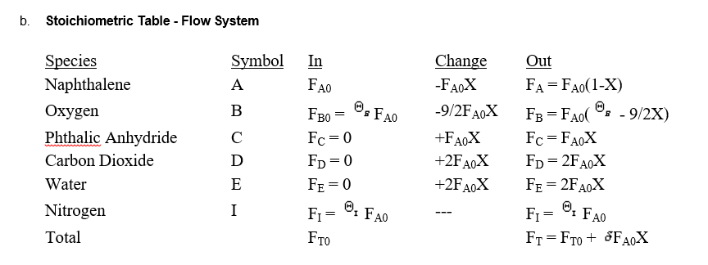
Fundamentals of CRE
Salah N. Farhan College of Engineering Diyala University

Slide 22
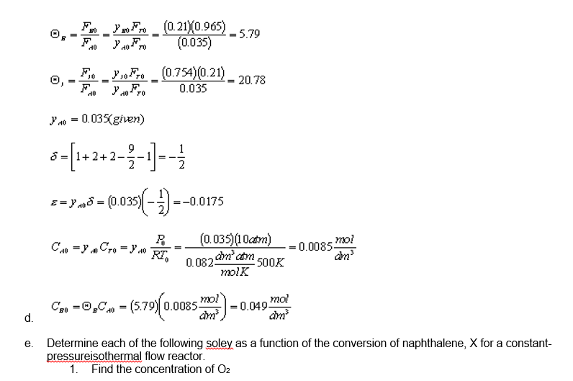
Fundamentals of CRE
Salah N. Farhan College of Engineering Diyala University

Slide 23
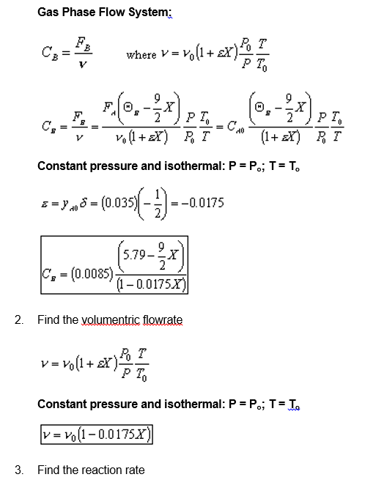
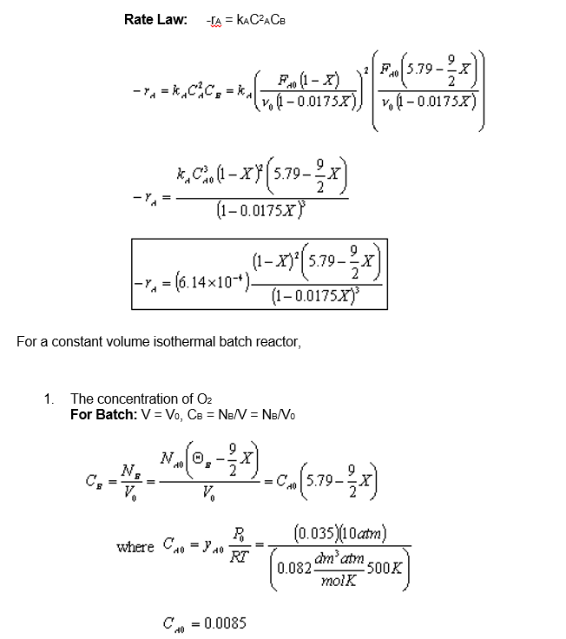
Fundamentals of CRE
Salah N. Farhan College of Engineering Diyala University

Slide 24
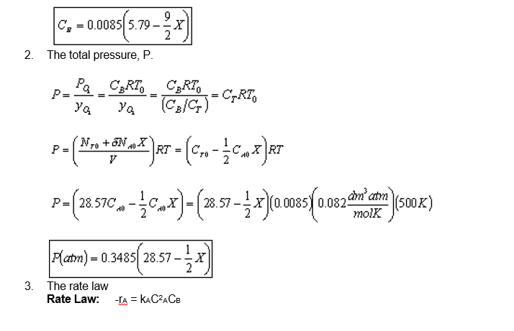
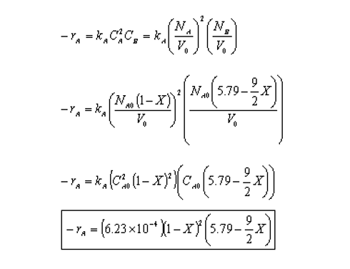
Fundamentals of CRE
Salah N. Farhan College of Engineering Diyala University

Slide 25
Fundamentals of CRE
Salah N. Farhan College of Engineering Diyala University

Slide 26
Fundamentals of CRE
Salah N. Farhan College of Engineering Diyala University

